Slide 1
Course Details
This part is 18 lectures
  Syllabus, slides/notes:
    http://www.aston.ac.uk/~blowkj/DataNetworks/index.htm
6 ATM lectures
  Given by Ashraf Khan
COMNET (M.Sc only)
  4 lab sessions of 3 hours each
Assessment (M.Sc)
  Lecture material 70%
  Course work 10%
  Lab assignments 20%
(M.Eng)
  Lecture Material 80%
  Course Work 20%
Notes:
This part of the course will cover issues that are specific to networking rather than transmission. Transmission issues are covered in other modules. We will also concentrate on packet networks rather than the public switched telephone network which is covered in module 3a.
In this series of lectures we will concentrate on concepts and use TCP/IP and the Internet as our main example. We will see how some of the concepts are used in practice as well as how some of the ideal principles are violated. ATM will be covered in a separate set of six lectures given by an external lecturer, Ashraf Khan.
The course material can be obtained at the web address given on the slide.
A practical laboratory course using the COMNET software simulation tool will be led by Dr W.Forysiak.

Slide 2
Logical vs Physical
e.g. These lectures
  18 logical lectures
  18 physical 1 hour slots
  may not be a simple mapping
addressing
  logical network addresses
    e.g. IP addresses
  physical network addresses
    e.g. wavelength
Notes:
One concept that is often used is logical vs physical. A logical description of a system contains information presented in a way that’s suitable for making a particular point. A physical description is the actual reality of a system.
A distributed database can be described in terms of the logical relationships between its parts or the physical distribution of the data.
This lecture course consists of 18 logical units which have to be given in 18 physical slots. The logical lectures may not correspond 1 to 1 with the physical slots.
Network addresses can be logical, e.g. IP addresses, or physical, e.g. A wavelength.

Slide 3
Data Networks
Transmission
  Sending data from A to B over a single link
  usually connection-oriented
  can be data independent
Networking
  Involves switching
  often involves specific types of data
Packet:
Header
Payload
Trailer
Notes:
In this lecture we will take a broad look at the features that distinguish a transmission line from network.
The single key characteristic of a network is that some form of switching or routing of the data is performed. A network that switches any form of data is known as transparent since the switching occurs without any knowledge of the data type or content. This directly implies that the transmission must be analogue in nature even if the data is sent as digital bits.
In a data network the digital nature of the data is accepted at the outset and is often built in to the specification and operation of the network. Flexibility is built in by separating out the routing information from the data to be transmitted and this is typically achieved through packetisation. The data to be transmitted is placed in the payload section of a packet, the address information is placed in the header section. In many cases the header carries much more than address information such as data type, error correction checksums and protocol information. In some cases, a trailer is included which might carry error correction or detection information.
Packets can be recursive, in that the payload of a packet can itself be a packet and so on.
We will principally be concerned with the properties of packet networks.

Slide 4
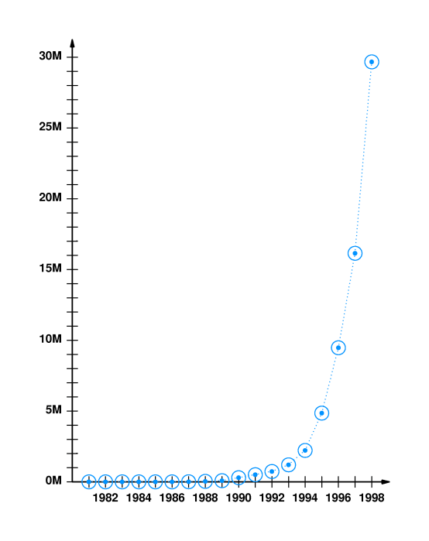
Internet Growth
Number of
connected
computers
Time
Notes:
The reason for concentrating on packet networks is basically the huge growth in the Internet which has happened over the last eight years or so. This graph shows the number of computers connected to the Internet as a function of time. The y-axis shows the number in millions of computers.

Slide 5
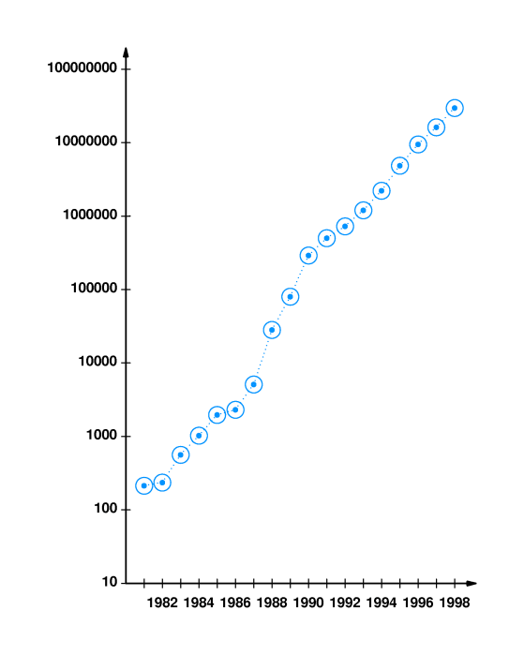
Internet Growth
Number of
connected
computers
Logarithmic plot
Time
Notes:
A logarithmic plot of the data shows the growth to have been exponential over a period of about sixteen years. This gives a growth rate of about 85% per year. If this were to continue unchecked, the whole world would be connected within about 10 years.
Why might we expect this explosive growth to saturate?

Slide 6
Single Link
B
Bandwidth
Error rate/ Signal to noise ratio
Data Rate
Failure probability
A
Notes:
Here we show a classic point to point link which is the domain of transmission systems. The link, which could be twisted pair, coaxial cable, microwave via satellite or optical fibre, has a number of important properties. The bandwidth which can be limited by the properties of the source, the receiver or the link itself. The error rate probability, for a digital line, or the signal to noise ratio, for an analogue line.
Typical bandwidths available are:
56kBit/s, Modem
2MBit/s Cable modem
10MBit/s, Ethernet
100MBit/s, Fast Ethernet
144MBit/s, ATM
2.5GBit/s, optical fibre link
Another important property is the failure probability of the link which might not even be limited by the components involved. For example, in certain undersea systems the mean time between failure is determined by ships (illegally) dragging their anchors during storms.

Slide 7
Network
Switched
Shared Access
Notes:
Here we show two network types.
A switched network consisting of pure point to point links, in this case joined together in a ring. A packet is placed on the network link by a node and propagates to the next node in the network. As a packet arrives at a node it is received and checked to see if it is at its correct destination. If it is then the packet is removed if not it is sent on to the next node and so on until it arrives at the correct node.
A shared access network consisting of a bus to which every node is attached. The packets are placed on the network, subject to an access protocol to avoid simultaneous use of the bus, and all the nodes look at the packet to see if it is for them but only the correct destination node would actually use the data.
These networks both have advantages and disadvantages.
The switched ring network allows many packets to be in transit at any one time. Some optimisation of flow is possible by placing nodes which communicate heavily with each other at adjacent points on the ring. These networks generally have to be bidirectional in order to allow for the possibility of a node crashing or a link failing.
The shared access network allows each node to communicate with any other node at the peak rate allowed by the bus but no guarantee of access to the bus is available. Nodes can be added and removed easily without (necessarily) disturbing the communication between the other nodes on the network.

Slide 8
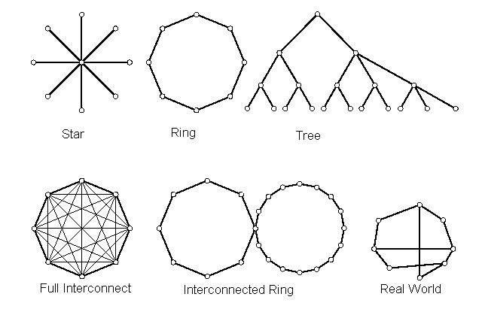
Topology
Notes:
The way in which the nodes of a network are connected to each other is known as the topology. The absolute position of a node is not important only the pattern of its connections to the other nodes.
There are a number of different topologies which are commonly referred to:
The star network consists of a central node to which all the other nodes are connected. This is a common configuration used in twisted pair Ethernets where the central node is a hub.
The ring network, which can be unidirectional or bidirectional.
The hierarchical tree, or nested star, has a multi level structure. This can be useful if the nodes can be ordered so that most communication takes place between adjacent nodes in a given level. As the nodes get further apart (within a level, not physically) then the packets have to rise up through more levels of the hierarchy.
The fully interconnected network isn’t really a network as we have defined it and is rarely used for more than a few nodes for reasons we shall see in the next slide.
The interconnected ring or sets of rings might occur when connecting different networks together, the common node being a router.
Finally there’s the real world which is not like any of the simple cases but contains elements of all of them.

Slide 9
Fully Interconnected Network
Network size of N nodes
So we have: L = N(N-1)/2 point to point links
Scales very badly with N
Incremental network cost is L(N+1)-L(N)
= (N+1)(N)/2- N(N-1)/2
= N
So the cost of adding a new node increases as the network grows, there is no economy of scale.
Notes:
The fully interconnected network would, at first glance, appear to be the ideal solution since no switching is necessary and every node can communicate over a dedicated link to every other node. The problem with this network is one of economics. In the slide you can see how the number of links depends on the number of nodes. For large N it increases quadratically with N.
This means that the incremental cost of adding a new node grows linearly with N so the network becomes increasingly expensive to grow. For telephone networks, where the nodes are users, the maximum number of calls that could possibly take place at any one time is N/2 and so most of the connections would not be in use for most of the time. Not a very efficient use of plant. In modern data networks, multicasting(*) is more prevalent so more simultaneous links are possible but still not enough to make this topology worthwhile.
(*) Multicasting is the sending of a single piece of information from one source to M nodes at the same time.

Slide 10
Network Problems
Routing information
Unique addresses
Rogue packets
Node/ switch/ router failures
Security
Internetworking
Abstraction
Quality of Service
Congestion
Flow Control
Errors
Network measurements
Applications
Notes:
This is a list of the sorts of problems and issues that network designers have to deal with.
Routing: how do we generate and maintain the necessary information?
Unique addresses: how do we ensure there are no duplicates?
Rogue packets: if an error occurs a packet might have a non-existent address.
Failures: What do we do when things go wrong?
Security: How do we keep data secret on a public network, How do I know the sender is who they claim to be?
Internetworking: How do I get data between networks using different protocols?
Abstraction: Do I really need to know everything to use a network?
Quality of Service: How can I stop someone from hogging the network resource?
Congestion: What happens when too many people use the network?
Flow Control: What happens if I can’t handle the incoming data fast enough?
Errors: How do I know the received packet is correct?
Measurements: How do the administrators know if there is a problem?
Applications: How do the applications used affect the provision of network resource?

Slide 11
Internet Resources
Tannenbaum home page
(http://www.cs.vu.nl/~ast)
Material on Comer Book
(http://netbook.cs.purdue.edu)
RFC’s
(http://www.rfc-editor.org/)
example - RFC 1288, finger
Notes:
Here are some links to resources available on the Internet. Tannenbaum’s and Comer’s home pages contain some material such as diagrams which are used in their books. They also contain some additional material which is not in the book.
The link to the RFC’s is a searchable site where the documents which define the Internet are stored. There are also links to other sites with related material.
Refernces for the Books:
Tanenbaum A.S, Computer Networks 3rd ed, Prentice Hall (1996) ISBN 0-13-349945-6
Computer Networks and Internets 2nd ed, D E. Comer, R E. Droms, Prentice Hall (1998), ISBN 0-13-083617-6

Slide 12
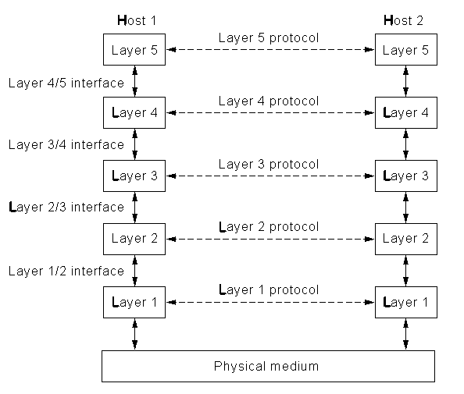
Next Lecture
Protocol stacks
  OSI
  TCP/IP
Notes:
In the next lecture we will look at the issue of abstraction. Why is it necessary? Is it unique? What do the layers do? How do their interfaces work?

